Slide 1
Senior Project Presentation Spring 2016
SkillCourt 4.0
Instructor: Masoud Sadjadi
School of Computing and Information Sciences Florida International University
Team Members: Product Owners: Luis Puche Jaime Borras
Sebastien Dolce Gumi Traustason

Slide 2
Problem Definition: Whole Project
Traditionally, the training for a soccer players is interaction with teammates, coach and the ball in a training field. However there are a few problems:
It requires a large field, and lack of space is a major setback for individual players as well as low budget soccer teams.
Training is cumbersome and discourages the average person.
There is no proper guidance without a coach.
Extensive training is required for coordination needed.

Slide 3
Problem Definition: SkillCourt 3.0
Shortcomings
Limitations on grid size.
No method of creating a sequence.
No sequence object standard.
No way to store or handle a sequence.
Processing as a back-end
No serial communication

Slide 4
Problem Definition: My Part
The creation of a SkillCourt sequence standard.
A local simulator for SkillCourt sequences.
Variable tile grid sizes.
Serial Handling.
New back end handling

Slide 5
Problem Management

Slide 6
Requirements: User Stories
#655 - Interpret and load simulation standard into virtual simulator.
#661 - Create a SkillCourt Sequence Standard.
#672 - Creation of custom-sized grids.
#676 – Communication to multiple pads.
#683 – Custom grid view.
#692 – SkillCourt Sequencer Wizard

Slide 7
Requirements: User Story #683
As a SkillCourt owner I would like to be able to load custom views from grids. So that a user can visually interact with any type of grid.
Acceptance Criteria:
Creation of buttons matching grid size and arrangement.
GUI Visually created using Nifty-gui
Export of Nifty-gui XML file
Creation of a virtual display object which can be called on demand.

Slide 8
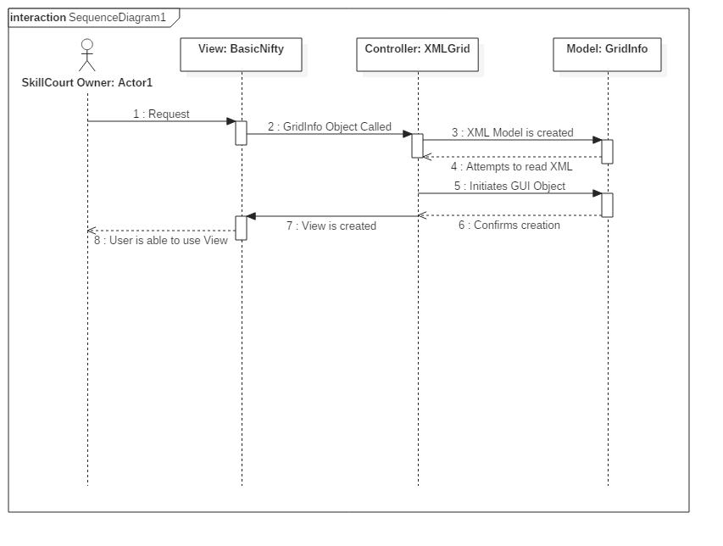
Requirements: Sequence Diagrams

Slide 9
System Design
The design uses an universal XML format, which can be stored in databases as well as opened no matter which system is used.
The design shifts from the usage of Processing IDE to a system that can be centralized.
Security: The security can be handled at the SkillCourt main controller instead of the app-side.

Slide 10
Test Case: Sunny Day
Test Case ID | UC683_01
Test Purpose | To determine sunny day functionality in GUI generation.
Test Setup | A valid GridInfo Object. Name: Griddy Rows: 3 Cols: 4
Test Output | GUI file was successfully exported as XML in determined output folder. views/filename.xml
Expected Output | System file successfully exported as views/filename.xml

Slide 11
Test Case: Rainy Day
Test Case ID | UC683_02
Test Purpose | Test to determine if a GUI can be created with invalid parameters.
Test Setup | Objects GridInfo Name: Griddy Rows: -3 Cols: 4
Test Output | GUI file was not exported exported as XML in determined output. Error was thrown.
Expected Output | GUI file not exported, error is thrown.

Slide 12
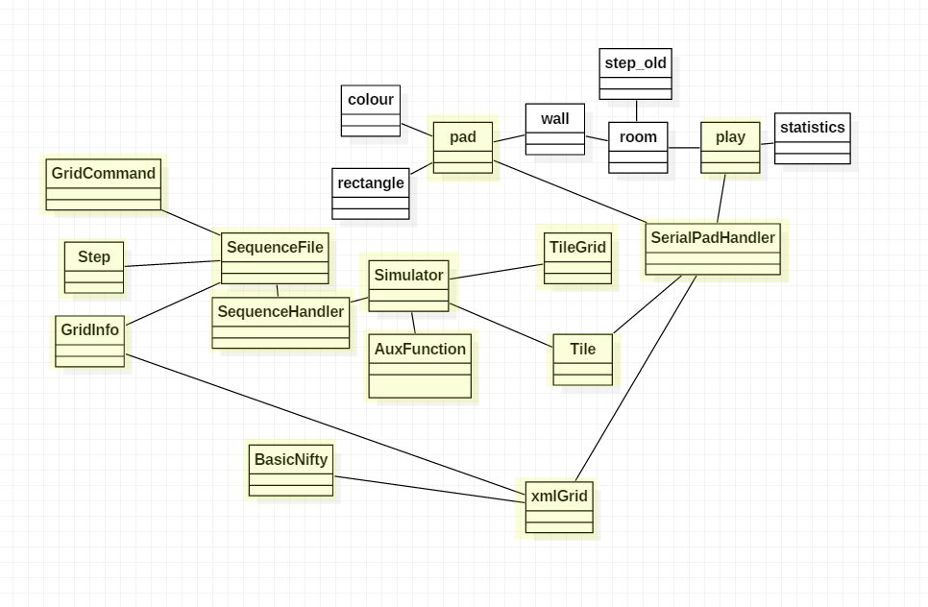
Minimal Class Diagram

Slide 13
Main algorithm
Creation of a grid GUI
A GridInfo object is fed to the interpreter.
The information about rows and colums are interpreted and exported as an nifty-XML document.
OpenGL is initiated through BasicNifty. Nifty uses Lightweight Java Game Library to provide a view from a class.
A user can now interact with the loaded view.

Slide 14
Summary
That is all about skillcourt and the new developments.
Luis Puche – lpuch002@fiu.edu
407-754-7818
Questions?
Thank you for watching!

Slide 15
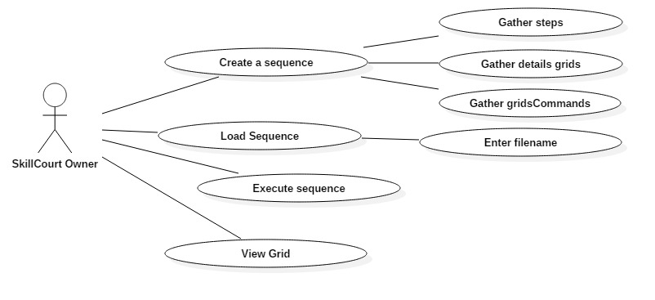
Use Case

Slide 16
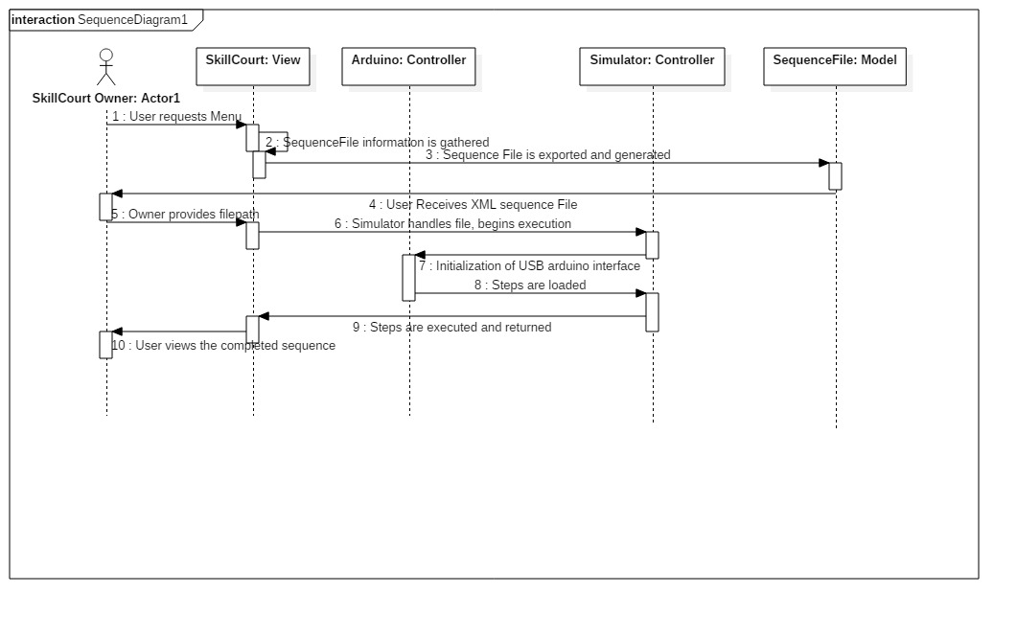
Sequence Diagram

Slide 17
Decomposition
Main System
Model
View
Controller
Sequence File
Skill Court UI
Simulator
AuxFunctions
Steps
Grids
Nifty UI
Serial Arduino
Grid Commands

Slide 18
Sequence Standard
The Sequence Standard
One of the problems that arose from testing was the inability to store a sequence for future use. Everything being randomly generated does not allow for comparison between players or expertly designed sequences.
Introducing the Sequence Standard!
Information
Stores the general information of the sequence in question.
Grids
These object store the general information about a grid, that is.. A set of tiles.
Steps
A sequence is divided into steps. This being commands which occur at the same time. Adding onto this, intervals as well as delays after the step is executed.
Grid Commands
Steps require that commands be sent to specific tiles in specific grids, Grid Commands handle the grid in question as well as their specific tile. From this, it also carries the action of what happens to the grid. This being the color

Slide 19
Security - old vs new
De-Centralized (Original)
The decentralized model does not require a central processor. Communication occurs from pad to pad directly.
Pros:
The pads can operate by themselves.
Can handle main pad failures.
Scalable
Modular in design.
Cons
Pads require more hardware.
All endpoints have to be secured.
Problems with version control.
Difficult to troubleshoot and maintain.
Centralized (New)
The centralized model requires a central processor. All communication goes from the processor then out to pads.
Pros:
Easier to maintain and troubleshoot.
More readily expandable.
Faster and more reliable.
Simpler pads.
Easier to secure.
Scalable
Ability to push updates to pads.
Cons
Must have central processor.
Requires a better main computer.

